Slide 1
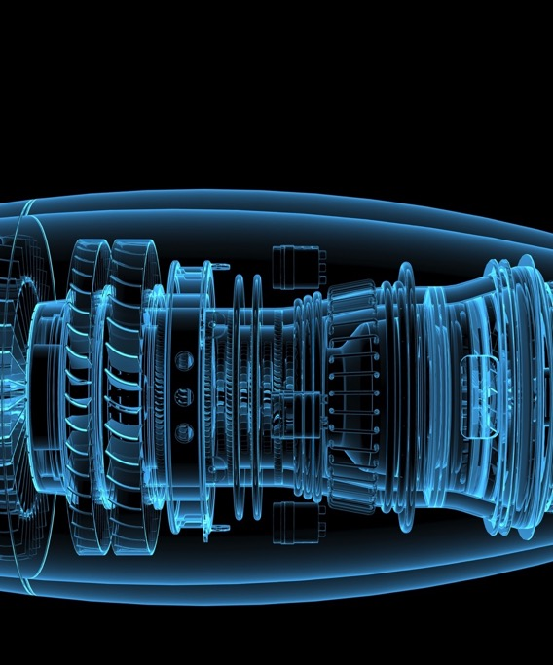
Introducing
IHS Engineering Workbench
Keith Dorrell
Account Executive
© 2016 IHS Markit. All Rights Reserved.

Slide 2
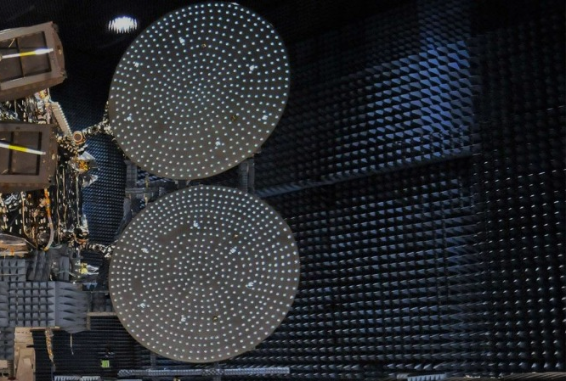
ENGINEERING & PRODUCT DESIGN
How much more could your engineers accomplish if they could sift through hundreds of internal and external standards and work procedures; trusted external sources, and millions of documents to find answers in seconds?

Slide 3

WHAT WE DO
ABOUT IHS Markit
For 57 years we have been offering information, analytics & expertise to organizations around the world.
They depend on our insights to help them make decisions about everything from day-to-day operations to long-term investments.
3,200+
Customers across industries
$3.3B
2015 sales combined
Airbus • BAE • Boeing • GE General Dynamics • L-3 Comm Lockheed Martin • NASA Northrop Grumman • Raytheon Textron • United Technologies
650K+
Engineering Users
Notes:
You may be familiar with us through the standards we provide. However, standards is just one aspect of the overall support we provide to engineers on a daily basis.

Slide 4

Engineers are drowning in information
ENGINEERING & PRODUCT DESIGN
40%
growth in data each year; meanwhile...
30-50%
of engineer’s time spent searching for information
30%
wasted duplicating research and work previously performed
IDC, 2015;
IHS, 2015
European Commission and
the European Patent Office, 2007
Notes:
[Talk track:] The challenge is that organizations have gotten very good at accumulating information, but we have lagged in improving our ability to help people find answers within all that information. As a result, the technical enterprise is awash in information. Research in this area suggests that technical workers are spending more and more time managing information, and less time actually using information and focusing on their core competencies. So we see that research gets duplicated as people spend time reinventing the wheel. Engineers spend too much time just collecting information before they can actually use it. For the broader enterprise, this has direct impacts on those key areas of focus that we mentioned: growth, profitability and risk. For example:
Researchers can’t assess future technology and intellectual property needs, leverage existing IP, or commercialize new ideas fast enough to stay ahead of the competition. That impacts the ability of a company to grow.
Engineering projects get stalled due to blocking technical issues, or they are held back by legacy design methods, or challenged to address design problems early in the project cycle, leading to redesign. That impacts profitability.
Or problems don’t get identified in time, and faulty products reach the market, resulting in exposure to financial liability or worse.

Slide 5




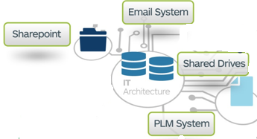
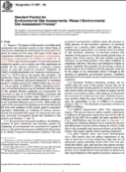
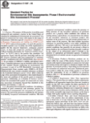

Introducing IHS Engineering Workbench
Combining the unique IHS Markit standards library with next-generation search technology, making essential industry standards...
  Easier to Discover
  Easier to Use
  Easier to Manage
...and connecting standards to third-party and internal technical reference content within a single platform.
Industry Standards
Technical Publications
Books
Journals
Patents
Vetted WWW Content
and Expertise
Corporate Knowledge
Internal Standards

Slide 6
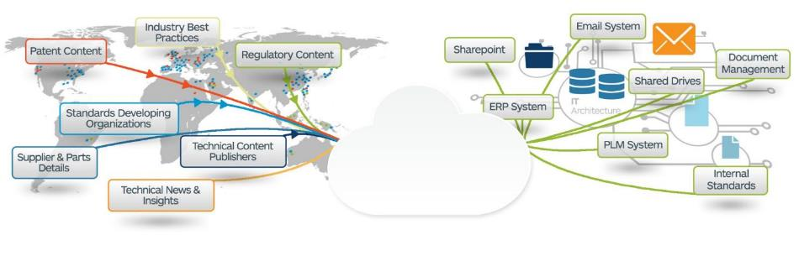


ENGINEERING & PRODUCT DESIGN
Engineering Intelligence informs decisions
Single Source of Trusted Authoritative Content from Inside and Outside the Organization
Improve Decision Process with Insight, Analytics, & Problem Solving
Based on results & data, make design changes, prototype, test again, & review new data
Technical Professional Needs to Solve a Problem
Define the Problem
Background Research
Specify Requirements
Brainstorm, Evaluate, Choose Solution
Develop Solution
Test Solution
Issue Closure

Slide 7
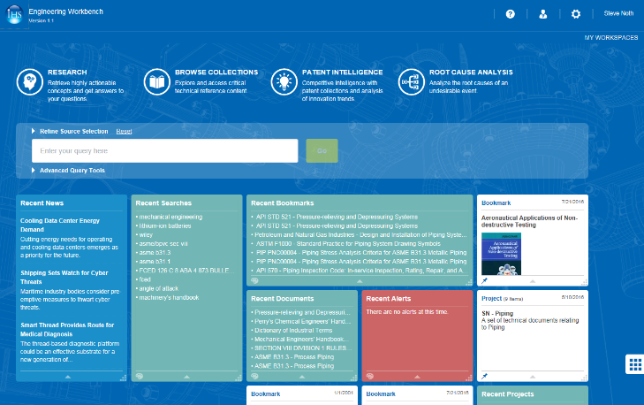
What is Engineering Workbench powered by Goldfire?
A single source for all internal & external technical information
Links external and internal content from many disparate and unstructured sources.
Find answers to complex engineering problems
No need to move data or create complex taxonomies – discover the information where it lives, regardless of how it is organized
Embeds seamlessly in existing engineering workflows and processes
Plugs into and enhances existing systems (i.e. PLM, SharePoint) – no need to replace these systems or create yet another data storage location

Slide 8


Engineering Workbench
New, simplified, modern interface delivering solutions to the engineering process worldwide.

Slide 9
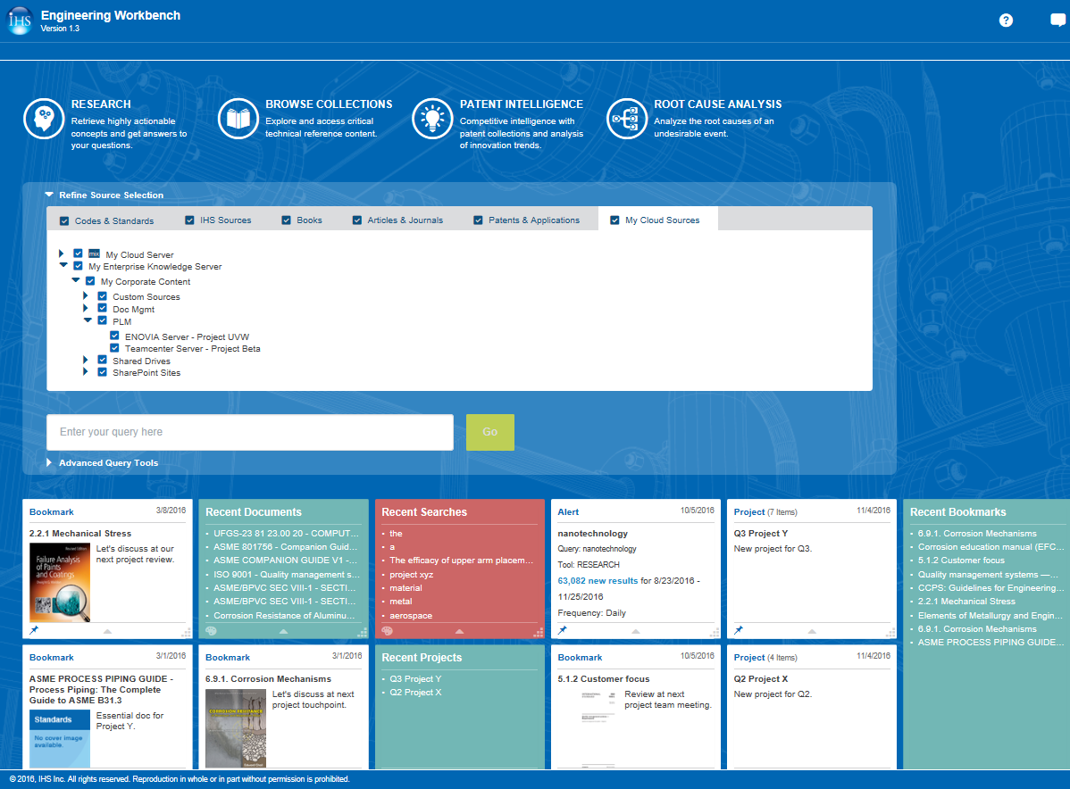
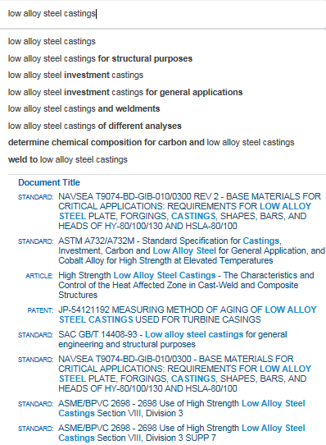
Discover information wherever it lives
Federated search across internal & external knowledge
Single “Intelligent Search”
Advanced Query Tools
Saved queries, project files, alerts and more
Integrated results – standards, reference content, internal docs

Slide 10
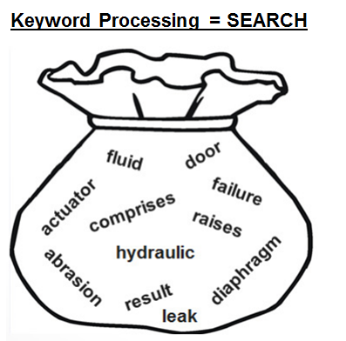
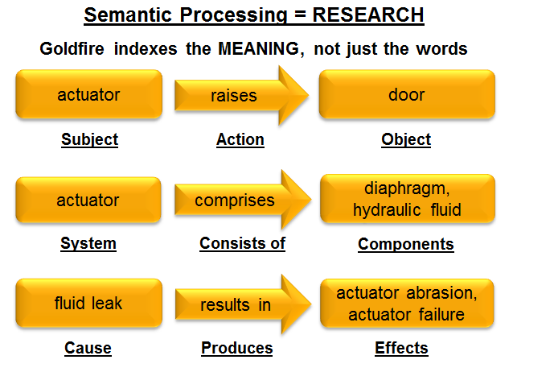
The actuator raises the door, it comprises a diaphragm and hydraulic fluid, but a fluid leak can result in abrasion and failure of the actuator.
Example: Google / Bing
Results driven by Popularity & Advertising $$
Example: Goldfire
Results driven only by Relevance
Notes:
Take a look at the sentence at the top of the slide – it’s just an example sentence, but it’s a fairly technical, complex sentence. Imagine this sentence is buried on some external website 10 links deep or on some internal shared drive 10 folders deep. If I index the sentence with traditional keyword technology I basically just end up with a big bag of words - there is no meaning, no context, no relationship BETWEEN the words in the bag.
Now, if I’m only looking for documents that happen to MENTION the word “actuator”, keyword search is pretty good at that.
But what if I have a more sophisticated, technical query? For example:
What does an actuator do?
What is an actuator made up of?
How does an actuator function?
Well then keyword search can’t help me, because it doesn’t even UNDERSTAND my query! Luckily, there’s a solution to this conundrum, and it’s called Goldfire.
When Goldfire indexes the sentence it CLASSIFIES the sentence into “SEMANTIC STRUCTURES” – these semantic structures then establish a MEANING FINGERPRINT. You can see a small sampling of them here. What that means to me as an end user is I can now treat Goldfire as my own, personal, VIRTUAL SUBJECT MATTER EXPERT and asks REAL questions – “what does an actuator do?”, “what does an actuator consists of?”

Slide 11

Delivering Real Customer Value
ENGINEERING & PRODUCT DESIGN
NASA Improve s Access to Critical Data Across Locations & Teams
Airbus Slashes Research Time
Mondelēz International Spurs Innovations & Efficiencies
80%
reduction in research time at
Airbus Space & Defense. IHS Markit Engineering Workbench allowed engineers to better leverage intellectual assets to avoid duplicate effort., improve ability to locate, identify & validate information sources. And the ability to easily access terabytes of internal knowledge.
Mondelez scientists using
IHS Markit Engineering Workbench in less than 6 month into deployment. In that time, Mondelez indexed over 230 globally distributed knowledge bases in 5 languages. Routine patent searches have been reduced from 2 weeks to just ½ a day.
of NASA personnel know
where information resides, but it was hidden in plain sight across millions of documents.
Using just one search term, IHS Markit Engineering Workbench Knowledge Discovery returned more than 200 contextually-relevant documents – some of these dated back to more than
40 years
30%
1100
Boston Scientific Boosts Patent Filings & Productivity
Monroe Energy Improves Operational Efficiency
Leading Aerospace Co. Reuses Knowledge to Optimize Design
improvement in productivity
among teams using IHS Markit Engineering Workbench, Users recaptured 70% of their lost time and focus on quality and revenue-generating projects. Within one year, 10-15% of patents filed by the cardiovascular division were generated with the help of Engineering Workbench.
in annual savings due to
accelerated research and other productivity gains. IHS Markit Engineering Workbench enabled Monroe Energy to help parent company, Delta Airlines, enable strategy to cut fuel costs by $300MM per year, while also accelerating productivity and
strengthening corporate governance.
20%
30%
$600K
reduction in Engineering
Change Orders (ECOs) representing a savings of 14,000 man hours. IHS Markit Engineering Workbench helped new team members come up to speed quickly and avoid repeating past mistakes.
Notes:
[Slide setup: These are extracts from authorized case studies, proof points on the ROI and value we deliver including content (Standards) and Enterprise Knowledge Discovery (Goldfire internal and external information); better our customers talk about us than us talking about ourselves- full case studies available on these]
Engineering Intelligence gives engineers the information they need for the task at hand – whether it’s ensuring regulatory compliance & sustainability, performing change & configuration management, or performing product support analysis & planning.

Slide 12
Infusing Intelligence into Engineering Workflows
ENGINEERING & PRODUCT DESIGN
Change & Configuration Management
Requirements Definition & Management
Regulatory Compliance & Sustainability Management
Quality & Reliability Management
Find the most relevant data for ECR validation (internal and external)
ECRs compliance with existing Codes, Standards and Patents
Reuse existing solutions for ECR analysis and validation
Requirements capture, documentation and reuse
Concept development & testing
Consumer experience documentation & testing
Industry requirements analysis & comparison
Material declaration and compliance assessment
Search and Reuse of existing internal material declarations
Compliance validation for external regulatory processes
Safety compliance and risk management
Non-conformance management (data reuse and validation)
Physical test management (problem-solving analytics)
Hazard and safety assessment
Concept Development
Detailed Development
Product Support Analysis & Planning
Onboarding/Talent Management
Idea generation & screening
Requirements assessment & validation
Concept development & marker testing
Consumer experience testing/validation
Business/ROI analysis & more
Design validation with Codes, Standards and Patents
Preliminary Design validation for requirements and cost
New product introduction process assessment
Existing products modification process assessment
Defect resolution management
Resource planning and layout
Production cost and efficiency analysis
Material compliance records and end-of-life regulation
Accelerate onboarding of new engineering talent
Bridge the knowledge gap between new talent and existing colleagues
Reduce over-reliance on most experienced engineers
Source: © 2016 IHS Markit. All Rights Reserved.
Notes:
Engineering Intelligence gives engineers the information they need for the task at hand – whether it’s ensuring regulatory compliance & sustainability, performing change & configuration management, or performing product support analysis & planning.

Slide 13
Return on Investment
C-Level Drivers | Initiatives | IHS Value Examples | Ranges of Customer Value
Grow Revenue | Identify new markets | New revenue opportunity identification 5% to 10% increase in intellectual property royalties | $1M - $100M
 | Better ideas | Deliver more competitively-differentiated solutions 70% improvement in ideation time | $1M - $100M
 | Faster time-to-market | 2.5 to 4 month acceleration of time-to-market with new products | $500K - $5M
Increase Profitability | Improve engineering productivity | 30% reduction in engineering time spent locating relevant technical knowledge 50% reduction of time spent recreating work already done | $500K - $2.5M
 | Increase quality | 1% to 5% improvement in manufacturing yield 2X to 5X reduction in product/process defects and failures | $500K - $5M
 | Reduce product cost | 5% to 10% reduction in manufacturing costs, including materials savings, energy savings, and process improvements | $500K - $5M
Minimize Risk | Ensure compliance with standards and regulations | Reduce regulatory non-compliance fines ($50,000/incident) Minimize recalls / litigation ($250,000-500,000+ / incident) | $250K - $2.5M
 |  | Total | $4M - $220M

Slide 14
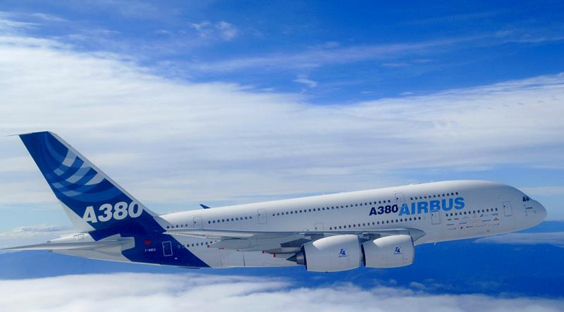



ENGINEERING & PRODUCT DESIGN
“
“IHS Goldfire is a real catalyst for innovation and is playing a key role in advancing the research and development efforts that
contribute to our company’s market-leading position in the launcher business.”
Denis Clerc
Senior Manager of Innovation
Airbus Defence & Space
“
Reduction in research time
at Airbus Space and Defense
Fully understand the company’s current intellectual assets to avoid duplicate effort
Locate, identify, & evaluate research from a wide variety of information sources
Researchers can readily access terabytes of internal knowledge

Slide 15

ENGINEERING & PRODUCT DESIGN
“
With IHS Goldfire, it is like having a single repository system without having to move everything into one system. We’re able to globally open up our internal content going back to the 1930’s, plus millions of documents in the hundreds of knowledge bases that come with it.”
Jonathan Gordon-Till
Sr. Associate Principal Scientist
Mondelēz
1100
“
Scientists using IHS Goldfire less than 6 months into deployment
Routine patent searching reduced from 2 weeks to ½ a day
Indexed over 230 globally distributed knowledge bases in 5 languages within the first 6 months

Slide 16



ENGINEERING & PRODUCT DESIGN
“
Engineers don’t reuse information because it’s difficult for them to find it. If they could find it in a couple hours instead of a couple of weeks they would. Otherwise they are going to have to recreate it themselves
David Meza
Chief Knowledge Architect
NASA Johnson Space Center
“
Of NASA personnel know where information resides, but it was hidden in plain sight across millions of documents before
IHS Goldfire
Using just one search term, IHS Goldfire returned more than 200 contextually-relevant documents – some of these dated back to more than 40 years
Notes:
In his book, Lost Knowledge, David DeLong writes about the knowledge loss crisis at NASA – and happening at organizations across industries and across the globe.
In 1969, Neil Armstrong became the first man to set foot on the moon, marking the culmination of a $24 billion NASA space program. Ten years later, NASA sheepishly admitted they could not return to the moon even if they wanted to - they couldn’t remember how.
This is a perfect example of what is referred to as the “Knowledge Gap;” or the loss of critical information when employees leave their place of employment. In the case of NASA, all the key people involved in the original Apollo 11 project had retired…and no one thought to jot down what they knew. To make matters worse, blueprints for Saturn V, the only rocket powerful enough to travel to the moon, were lost.
Even though this NASA fumble took place 30 years ago, the exact scenario is being played out in spades as Baby Boomers (those individuals born between 1946 and 1964) are reaching retirement age, and most employers have made no effort to capture the Boomers’ knowledge before they eventually leave.

Slide 17
Questions?

